Slide 1
Fastech Projects pvt ltd Corporate Profile

Slide 2
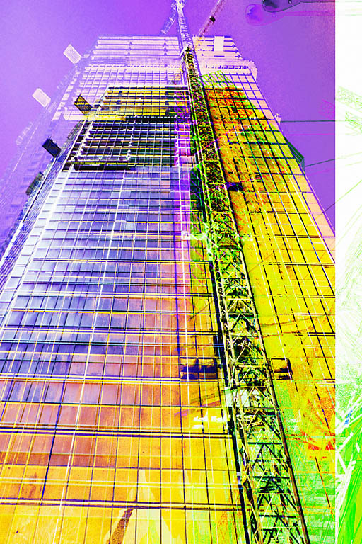
Contents:
Introduction
Key Professionals
About us
Our services
Civil Structure Construction
Work capabilities
Completed Projects
Ongoing Projects
Activities
List of Plant & Machinery
Contact Details

Slide 3
Introduction:
Fastech Group has built & developed state-of-the-art architectural landmarks in Delhi, NCR and Northern India having a good experience of 20 years in the construction industry.
Commitment, credibility, customer faith, safety and quality work, these are the pillars on which the foundation of Fastech Group is laid. The company is continuously working towards adopting latest technologies of the construction industry.
The Company is well equipped with sufficient Tools & Plants, Machineries, man powers, technical and professionals, administrative and Human resources persons. We always given high priority towards quality control, safety measures and timely completion of work at site.
Achievement:- Now we are constructing more than 75 Lacs Sqft
(approx. 7.5 million) Area
We have already handed over more than 1300 flats successfully directly to the customers

Slide 4
Management - Directors :-
Mr. PRAVEEN KUMAR
Praveen Kumar a dynamic and well known name in the Construction industry in Delhi, NCR and North India. He possesses distinct quality of being a result oriented performer and a great team leader. Attention to detail and to see the unseen is his second nature.
having over 20 years of enriched experience in construction industry with planning, construction, management, quality.
Mr. PARUL SINGHAL (FCA)
Professional chartered accountant with over 20 years of enriched experience in real estate projects, He’s expertise and confident has managed all aspects of development & Constructions work in Delhi, NCR and North India .
He has miraculously, executed his jobs to the satisfaction of the client’s needs. His particular expertise is in real estate projects like sales, marketing , promotion, purchase, procurements of material, administration, finance and business development .

Slide 5
Our Specialization:-
Fastech group provides superior Civil Constructions of buildings including the structure, services, finishing, external development and other works. We have already doing numerous residential projects and I.T. projects with their development works in Delhi,NCR and Rajasthan
Fastech brings a fresh and innovative approach to contracting services, acting as liaison between the end-user and the client. Our goal is to exceed the expectations of every client by offering outstanding quality, safety, within budget & on time completion.
As an experts in building constructions, Fastech is involved in every stage of constructions from implementation to completion of the project .Our extensive skills encompass all aspects of implementation of right quality & time frame.

Slide 6
Civil Construction & Finishing work :-
F
Fastech’s success and reputation of excellence is a direct result of our superior management & contracting systems .We have specialisation to achieve the work target in time on Multistoryed buildings.
This ensures perfect synchronization of manpower, equipment, construction schedules, materials procurement /sourcing and availability. The result is optimal utilization of men, machines, finances and resources to deliver quality constructions on time and to defined costs.
Dedicated site teams engaged in primary construction activities and are supported by back-end teams to ensure timely implementation of the project and quality of the highest standards. All linked together by efficient communications and Information Technology.

Slide 7
Financial Turnover :
S.NO. | FINANCIAL YEAR | Annual Turnover (RS.)App.
1 | 2010-2011 | Rs. 9 Crores
2 | 2011-2012 | Rs. 50 Crores
3 | 2012-2013 | Rs. 80 Crores
4 | 2013-2014 | Rs. 135 Crores
5 | 2014-2015 | Rs. 148 Crores
6 | 2015-2016 | Rs. 96 Crores
7 | 2016-2017 | Rs. 60 Crores
Our Bankers :
S.NO. | BANK | LOCATION
1 | Axis Bank | Plot no. 4, Aditya Corporate Plaza, Community center, Karkardooma, Delhi : 110092.
2 | Vijaya Bank | 1/3732, Timber Market, Loni road, Shahdara, Delhi-92

Slide 8
Work Capabilities & Specialization :
Civil & Structure
Finishing & Interior
Internal and External Plumbing
Internal and External Electrification
Fire Fighting
External Development with Road
Horticulture and Landscaping
Lift and Façade work
Ventilation and HVAC
External drainage and STP
Township development
HT , LT panel and Transformer

Slide 9
Our Clients:-

Slide 10
Completed Projects :-
The Hyde Park, Sector – 78, Noida (Phase-I)
Construction & development of 1096 multi-storeyed flats comprising of 4 bed rooms, 3 bed rooms and 2 bed rooms flats, having 07 towers of Double basement, G+21 storeyed including Civil work, Finishing work, Internal water supply and plumbing work, Internal Electrification work, Lift work, Fire Fighting work, External Electrification work, External Storm water, drainage, water supply work, Road, Pathways, Landscaping, Street light, Power back-up, Boundary wall, Solar system, Club, Shopping mall, Swimming pool etc.
Client : M/S. IITL-NIMBUS THE HYDE PARK NOIDA, DELHI
Area : 23 lacs square feet approx.
Value : Rs. 225 crore approx.
Achievent : Already more than 600 flats handed over successfully directly to the Customer
The Golden Palm, Sector – 168, Noida
Construction & development of 480 multi-storeyed flats comprising of Four bed rooms, Three bed rooms and Two bed rooms flats, having 5 towers of Double basement, G+22 storeyed including Civil work, Finishing work, Internal water supply and plumbing work, Internal Electrification work, Lift work, Fire Fighting work, External Electrification work, External Storm water, drainage, water supply work, Road, Pathways, Landscaping, Street light, Power back-up, Boundary wall, Solar system, Club, Shopping mall, Swimming pool etc.
Client : M/S. CAPITAL INFRA PROJECTS PVT. LTD.
Area : 12.50 lac square feet approx.
Value : 125 crore approx.
Achievent : Already more than 200 flats handed over successfully directly to the Customer

Slide 11
Completed Projects :-
6. The Origins, Suncity Township, Jaipur, Rajasthan
Construction and development of 153 multi-storeyed flats comprising of Three bed rooms, Two bed rooms, having 4 towers of STILT, G+9 storeyed including Civil work, Finishing work, Internal water supply and plumbing work, Internal Electrification work, Lift work, Fire Fighting work, External Electrification work, External Storm water, drainage, water supply work, Road, Pathways, Landscaping, Street light, Power back-up, Boundary wall, Solar system, Club, Shops etc. This is turnkey project
Client : M/S. ORIGIN BUILDWELL PVT LTD.
Area : 2.25 lac square feet.
Value : Rs. 15 crore approx.
Acheivement : All 153 flats has successfully handed over to the client.
4. Express park view- I, Sect.–Chi-V,Greater Noida
Finishing and development of 334 multi-storeyed flats comprising of Three bed rooms, Two bed rooms and one bed room flats, having 4 towers of single basement, G+17 storeyed including Civil work, Finishing work, Internal water supply and plumbing work, Internal Electrification work, Lift work, Fire Fighting work, External Electrification work, External Storm water, drainage, water supply work, Road, Pathways, Landscaping, Street light, Power back-up, Boundary wall, Solar system, Club, Shops, Swimming pool etc.
Client : M/S. IITL PROJECTS LIMITED & NIMBUS PROJECTS LIMITED
Area : 3.35 lacs sq.feet
Value : Rs. 25 crore approx.
Achievement : All 334 flats successfully handed over directly to the Customers.

Slide 12
Commercial Project :-
7. “Parikrama”, Sector-20, Panchkula, Haryana
Complete finishing work of 369 multi-storeyed flats comprising of 3 bed rooms, 4 bed rooms, 5 bed rooms & Pent Houses, having 8 towers, G+17/18 Storeyed including civil work, Finishing work, Internal water supply and plumbing work, Internal Electrification work, Lift work, Fire Fighting work, Air Conditioning work, Aluminum work, Flooring work, Chinaware, C.P Fittings, Door Hardware etc.
Client : M/S. SUNCITY PROJECTS PRIVATE LIMITED
Area : 8.5 lacs sq.feet
Value : Rs. 40 Crore Approx
8. “The Hyde Plaza ”, Sec-78, Noida at “The Hyde Park” Sec-78, Noida
Commercial Building (Lower Ground+ Ground+ First Floor) having 58 shops on all floors with lifts and facade
Area : 25000 sq. feet Approx
Achievement : all shops successfully handed over to the client

Slide 13
On- Going Projects :-
1. Indosam-75, Sector – 75, Noida
Construction of 549 multi-storeyed flats comprising of Four bed rooms, Three bed rooms
and Two bed rooms flats, having 4 towers of Double basement, G+24/18 storeyed including
Civil work, Brick work, Plaster work, Door work etc.
Client : M/S. INDOSAM INFRA PVT. LTD.
Area : 8 lacs square feet.
Value : Rs. 30 .50 crore approx.
2. Express Park View-II, Sect. -Chi-V,Greater,Noida
Construction & development of 1764 multi-storeyed flats comprising of Four bed rooms,
Three bed rooms and Two bed rooms flats, having 14 towers of Single basement, G+20 storeyed
including Civil work, Finishing work, Internal water supply and plumbing work, Internal
Electrification work, Lift work, Fire Fighting work, External Electrification work, External Storm
water, drainage, water supply work, Road, Pathways, Landscaping, Street light, Power back-up,
Boundary wall, Solar system, Club, Shopping mall, swimming pool etc. This is complete turn key
projects.
Client : M/S. IITL-NIMBUS THE EXPRESS PARK VIEW, DELHI
Area : 25 lacs square feet approx.
Value : Rs. 400 crore approx.
Achievement : Phase-I flats possession is going to be open soon.

Slide 14
On- Going Projects :-
9. “Vinpar Project at Noida” , Sector-142,Noida
Civil Structure work of I.T. Building Project (Double Basement+ Ground+Twelve floors)
Client : M/s. VINPAR SOFTECH PRIVATE LIMITED
Area : 1.25 lac sq. feet Approx
Value : Rs. 10 Crore Approx
10. CHD Green Park Residency”, Sector- 45, Karnal, Haryana
Complete Finishing & Civil Structure work of Independent Floors at their city on turnkey basis.
Client : M/s. CHD DEVELOPERS LIMITED
FASTECH PROJECTS PRIVATE LIMITED .
www.fastech.co.in

Slide 15
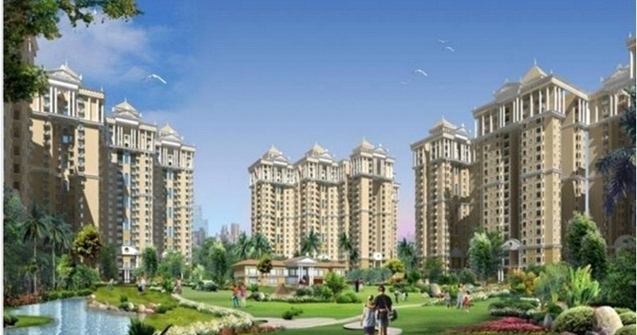
THE HYDE PARK - Multistoried Apartments at Sector -78, Noida.
(Actual view)
(Architect view)

Slide 16
THE HYDE PARK - Multistoried Apartments at Sector -78, Noida.
(Actual view)

Slide 17
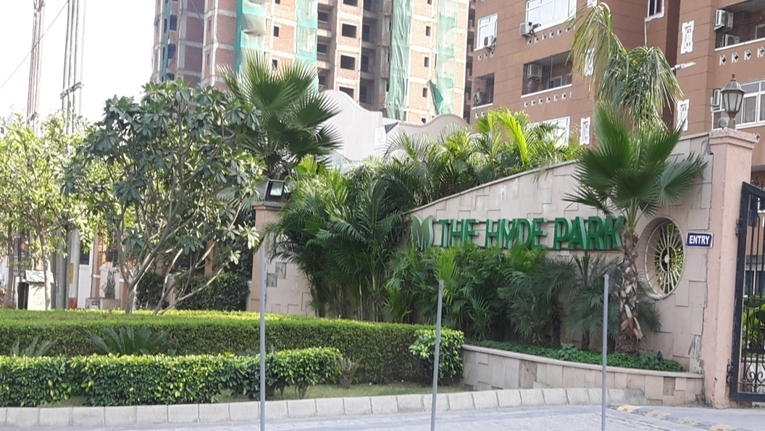
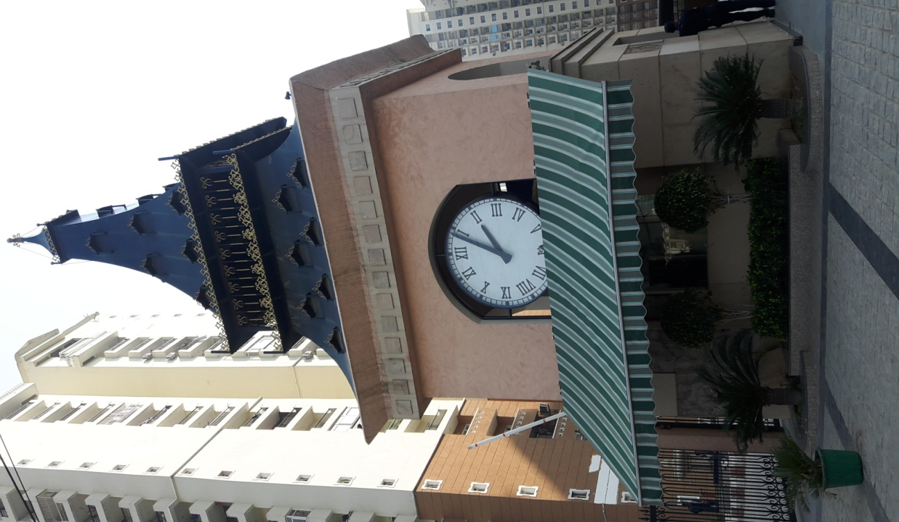
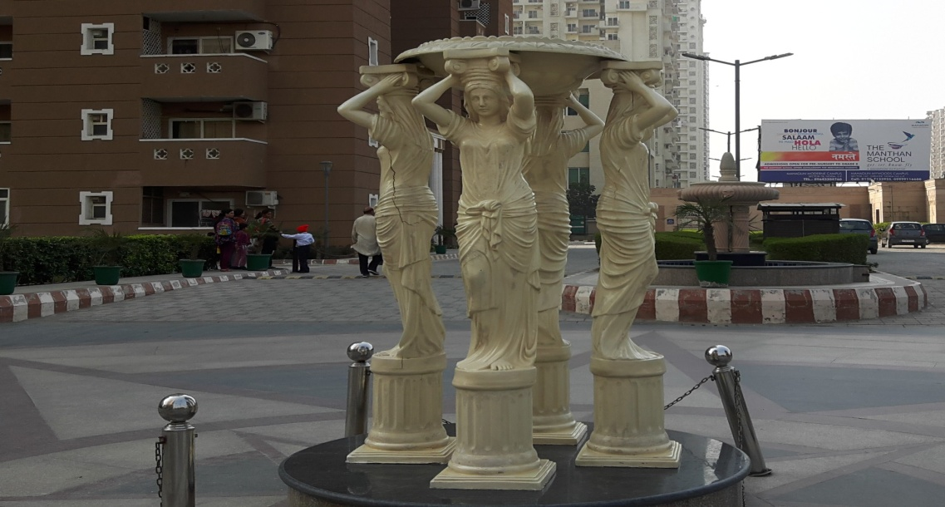
“THE HYDE PARK” Project at Sector-78, Noida:-
(Actual view)

Slide 18
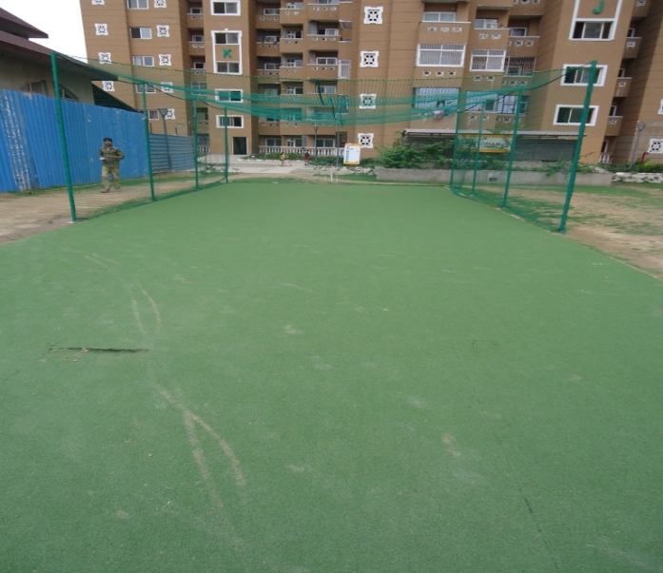
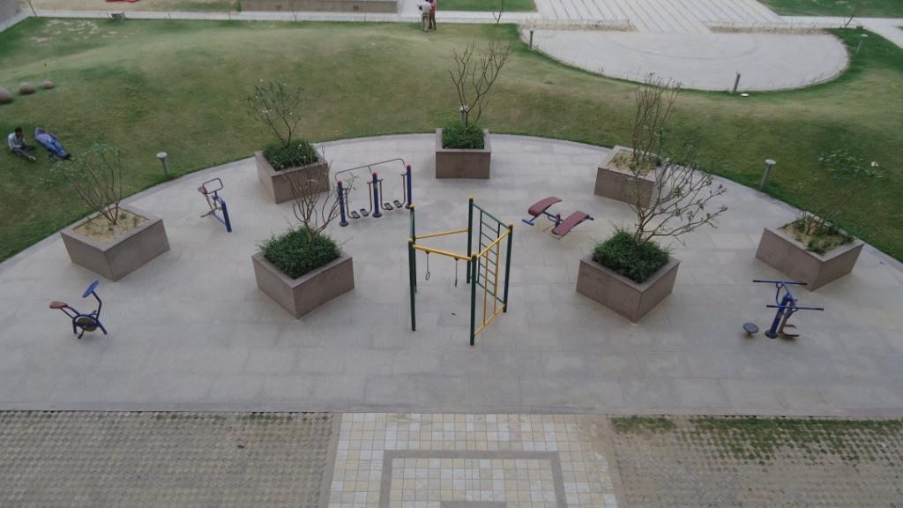
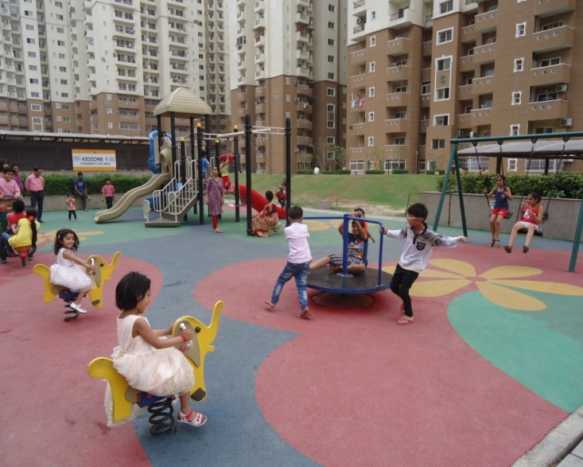
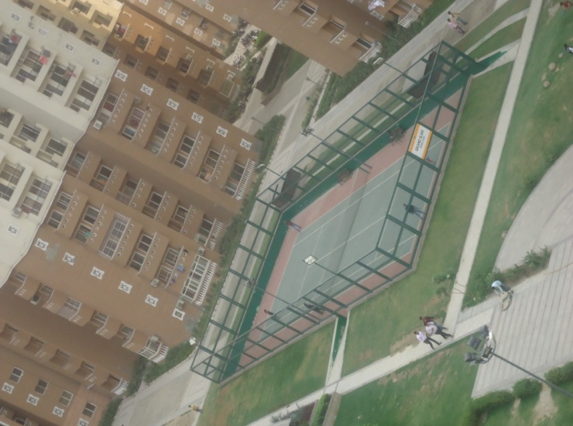
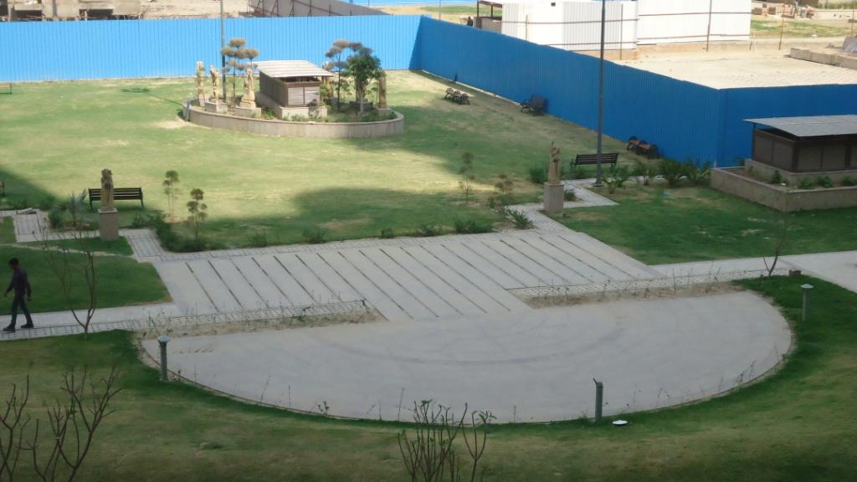
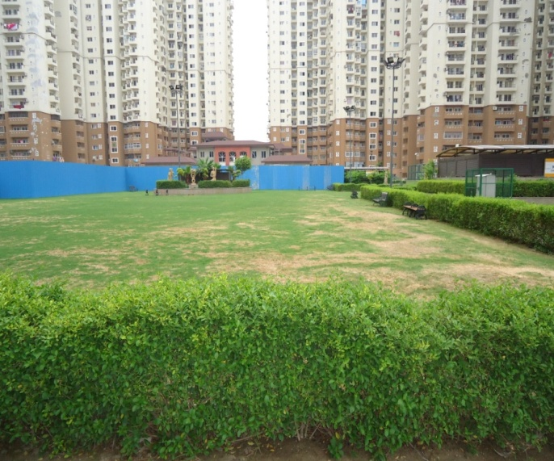
“THE HYDE PARK” (Central Park) at Sector-78, Noida:-
(Actual view)

Slide 19
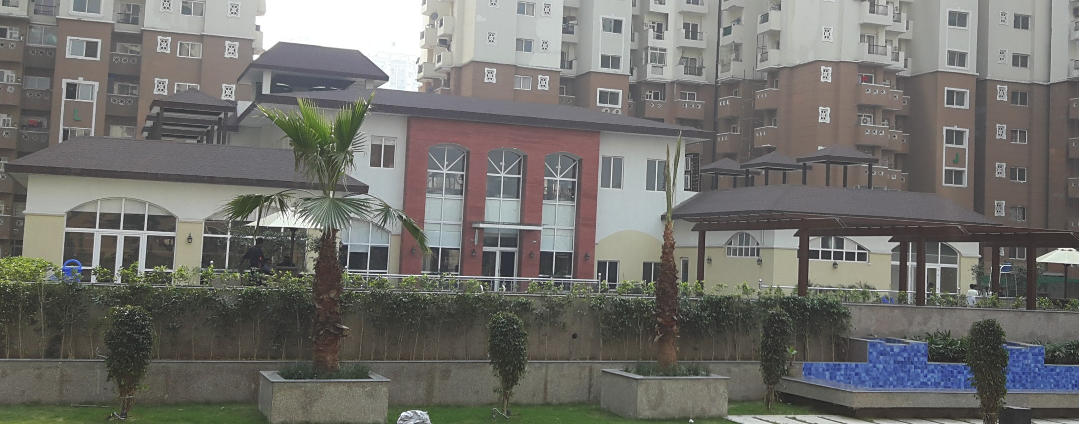
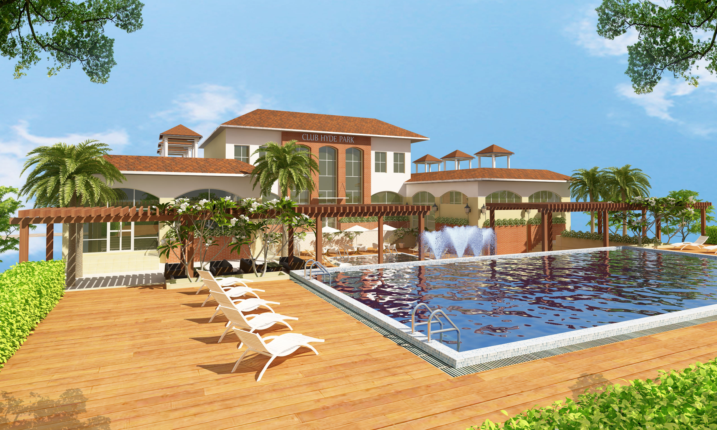
Club House at The Hyde Park, Sector-78, Noida:-
(Actual view)
(Architect view)

Slide 20
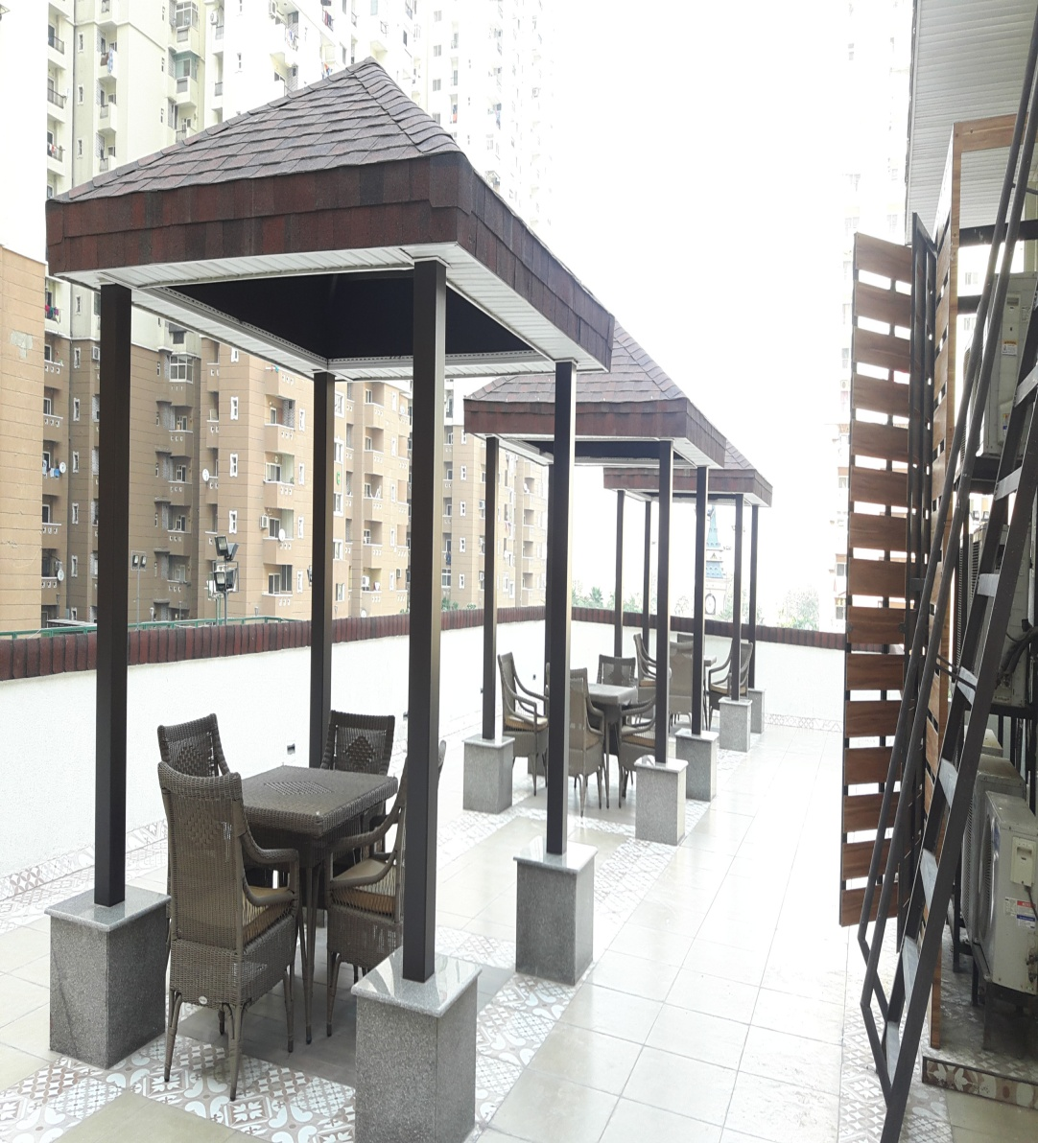
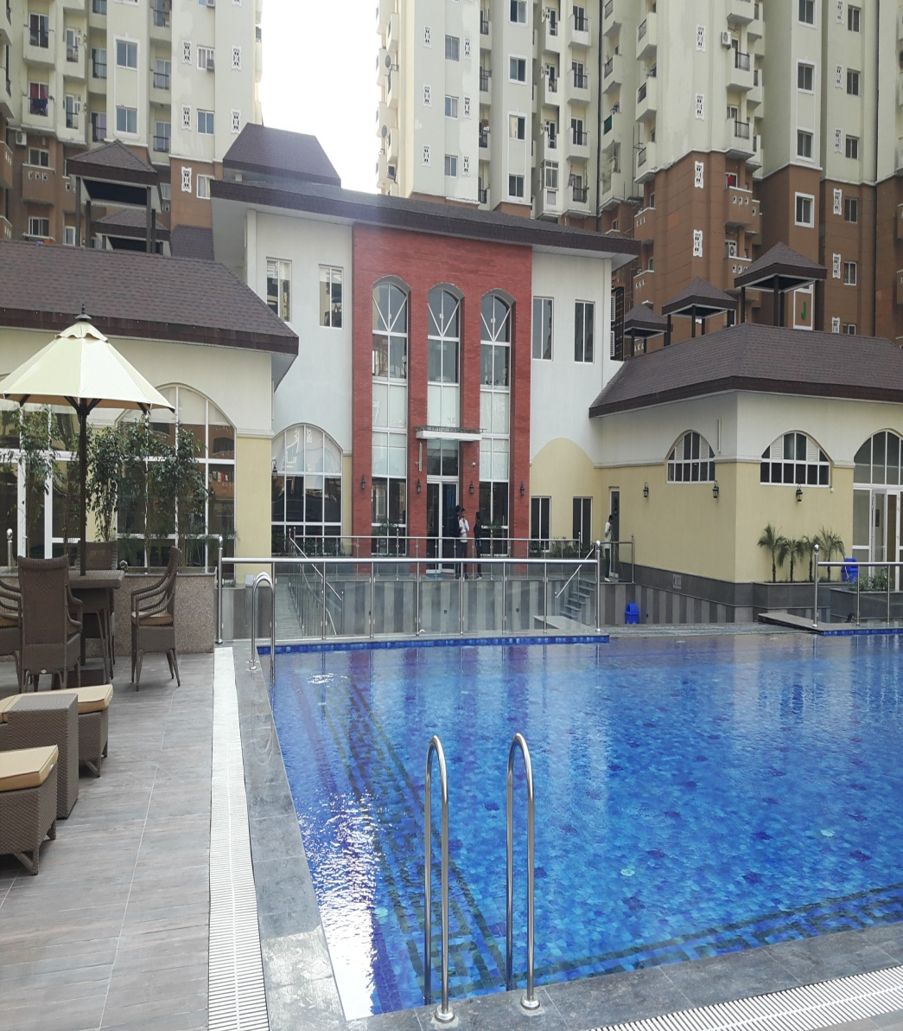
Club House at The Hyde Park, Sector-78, Noida:-
(Actual view)

Slide 21
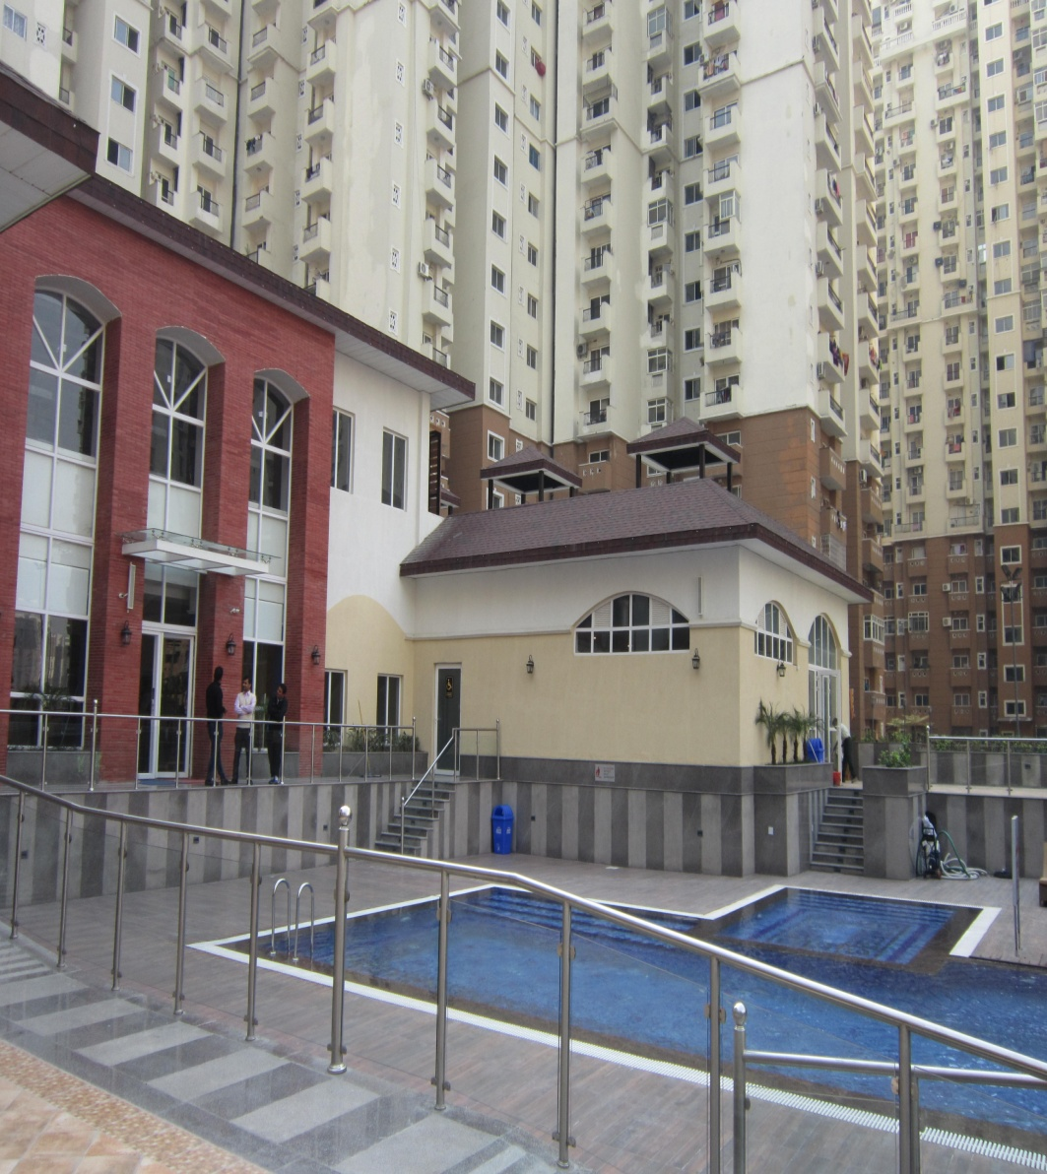
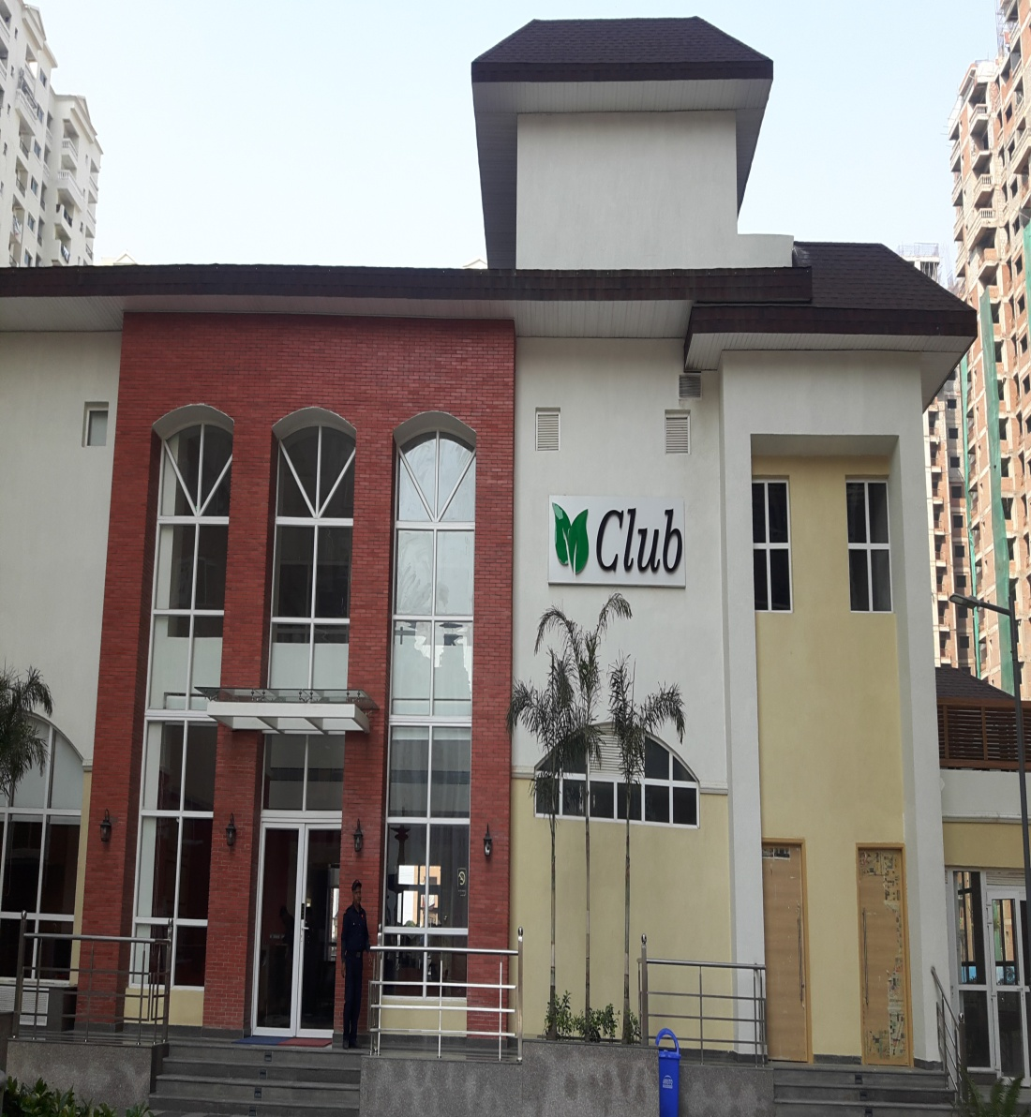
Club House at The Hyde Park, Sector-78, Noida:-
(Actual view)

Slide 22
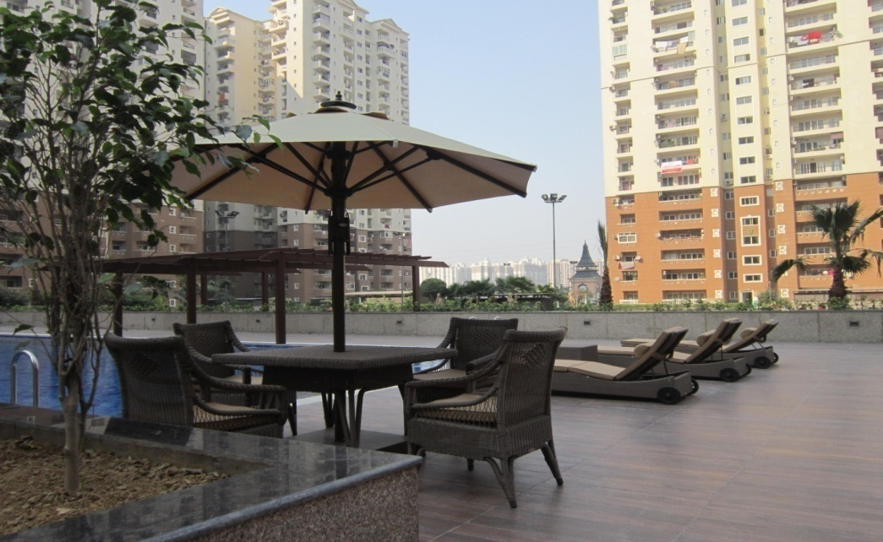
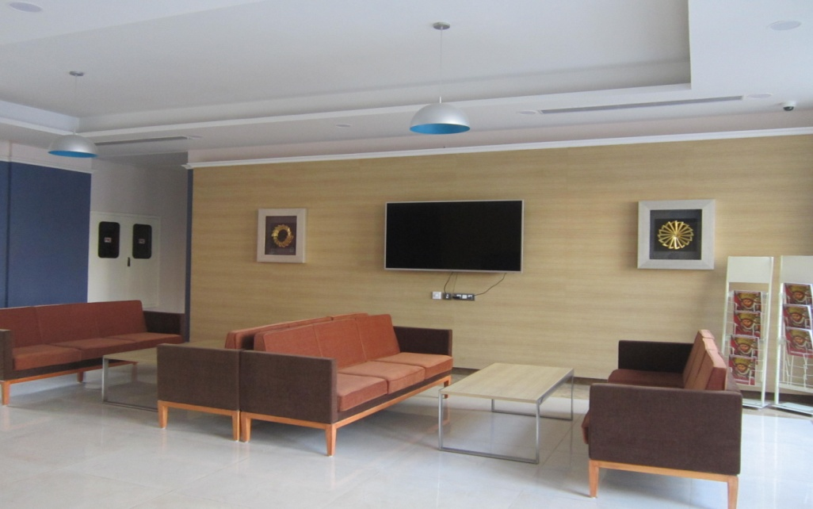
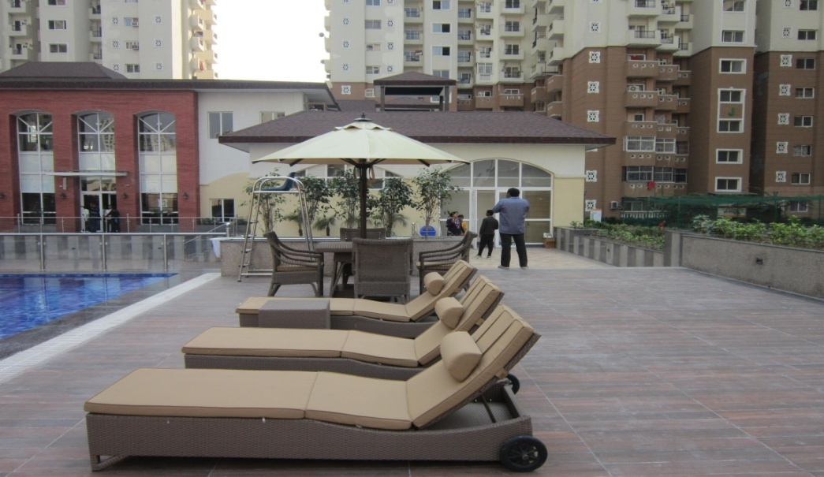
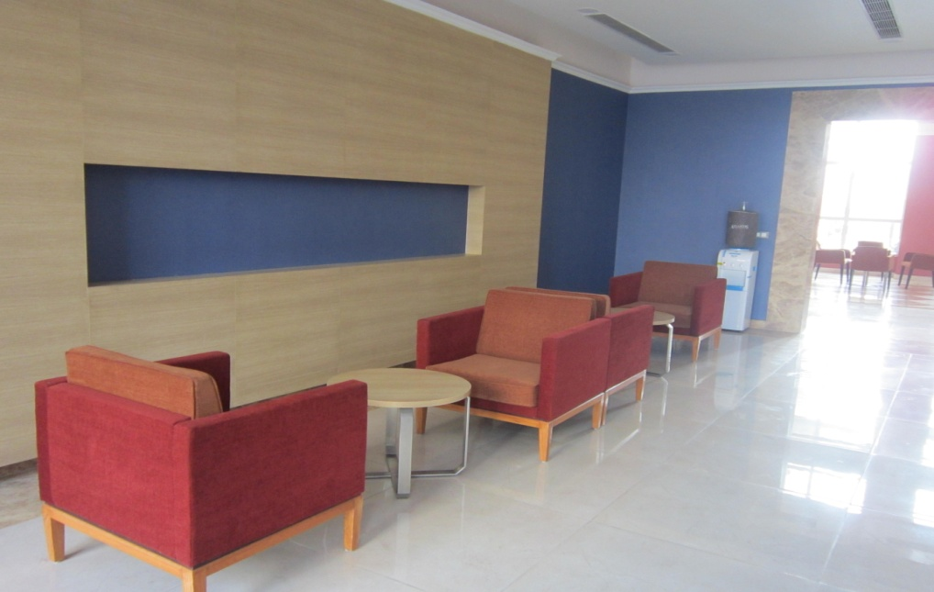
Club House at The Hyde Park, Sector-78, Noida:-
(Actual view)

Slide 23
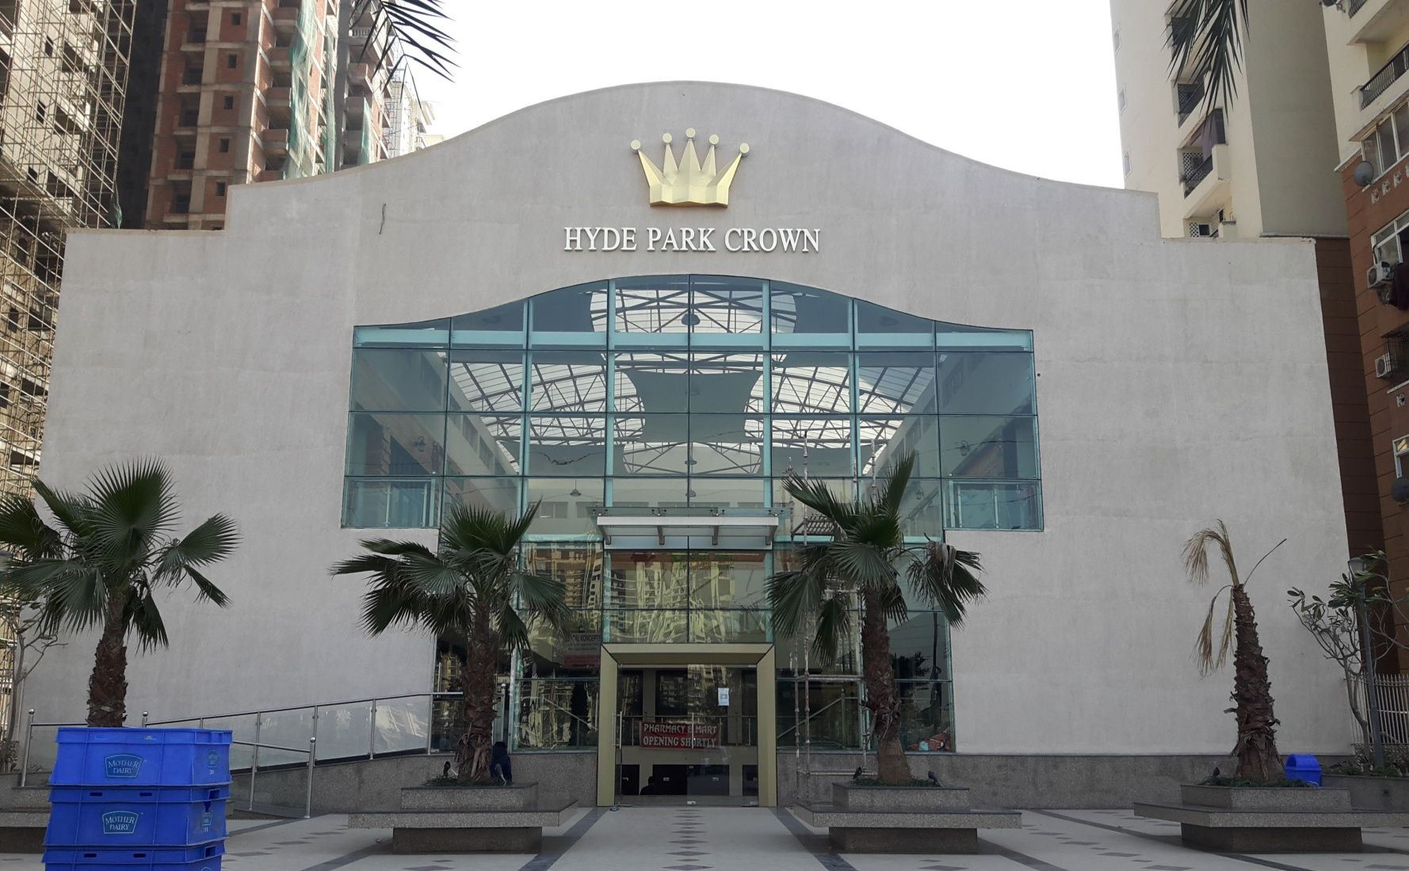
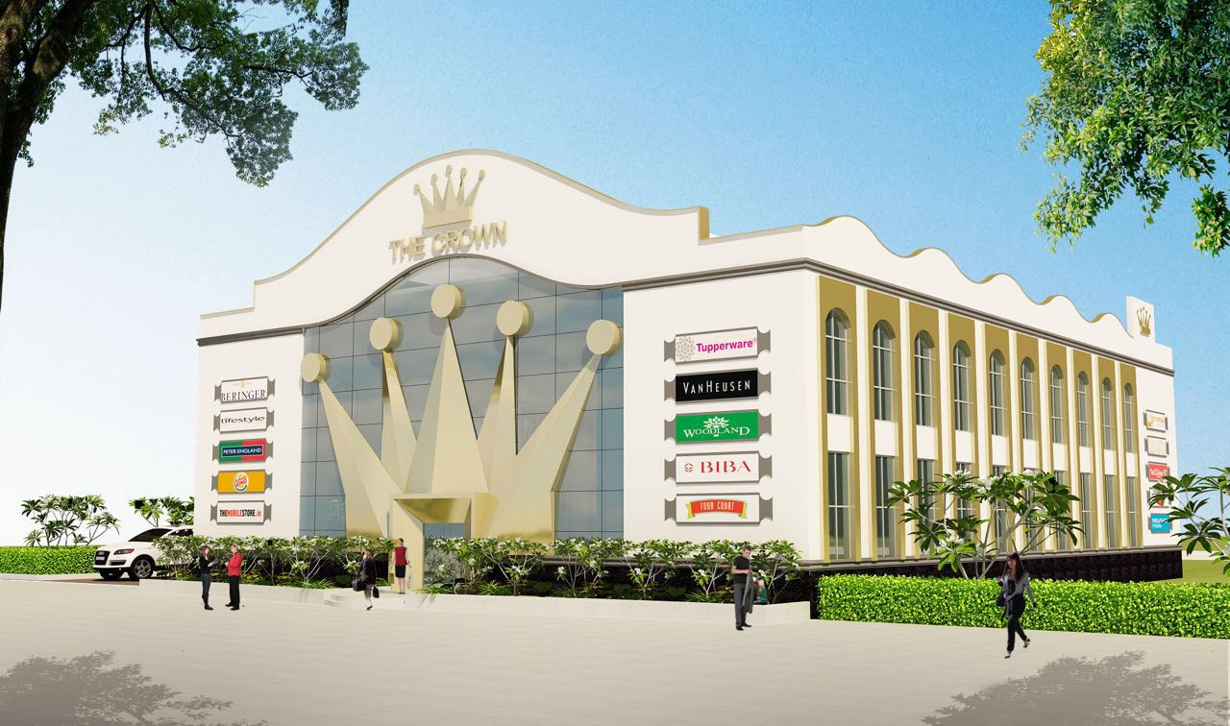
“The Hyde Plaza” Commercial Building at “The Hyde Park”, Sec-78, Noida :-
(Actual view)
(Architect view)

Slide 24
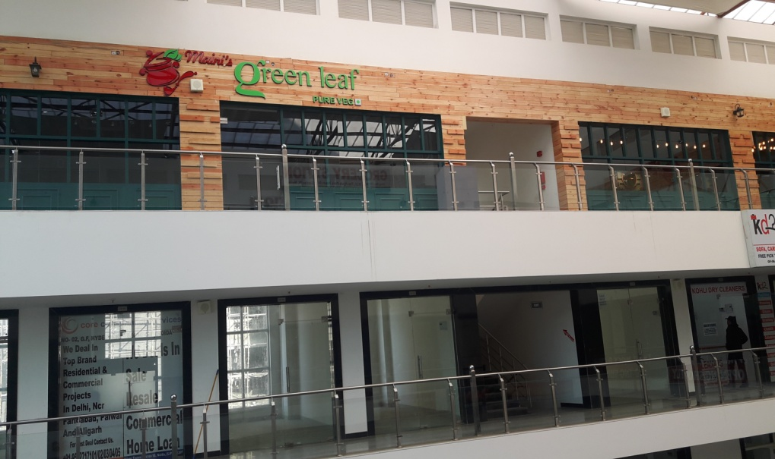
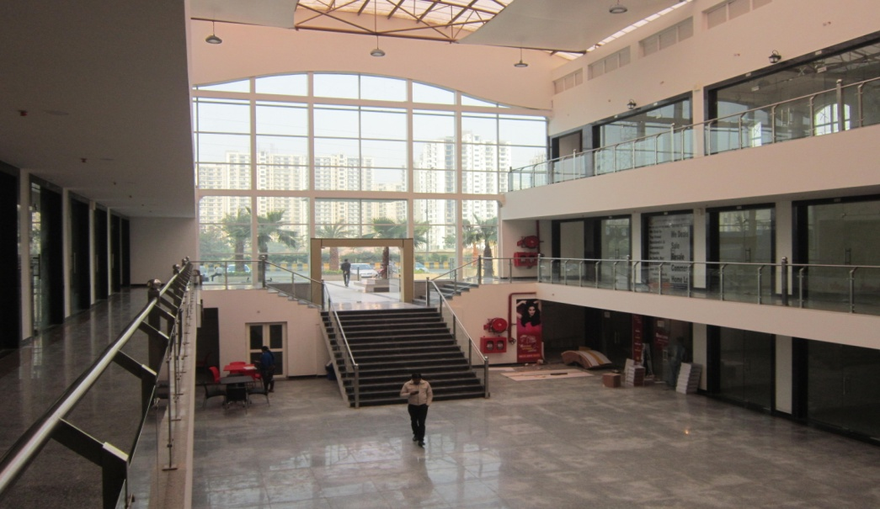
“The Hyde Plaza” Commercial Building at “The Hyde Park”, Sec-78, Noida :-
(Actual view)

Slide 25
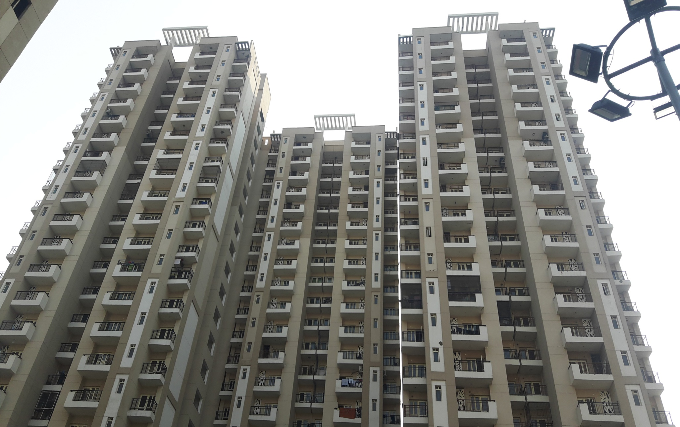
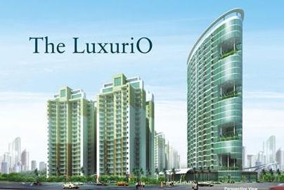
THE GOLDEN PALMS - Multistoryed Apartments at Sector -168, Noida:-
(Actual view)
(Architect view)

Slide 26
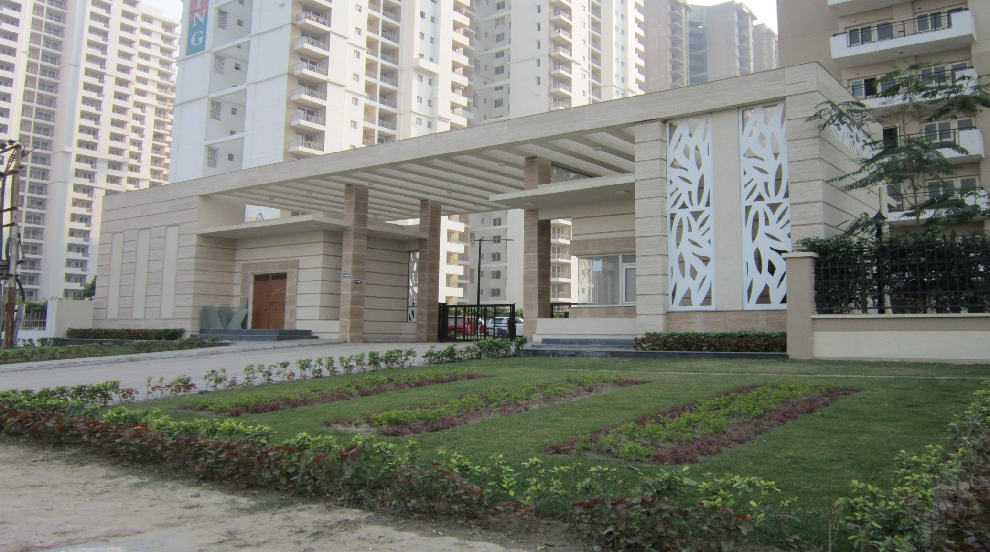
THE GOLDEN PALMS – Main Entrance Gate at Sector-168, Noida:-
(Actual view)

Slide 27
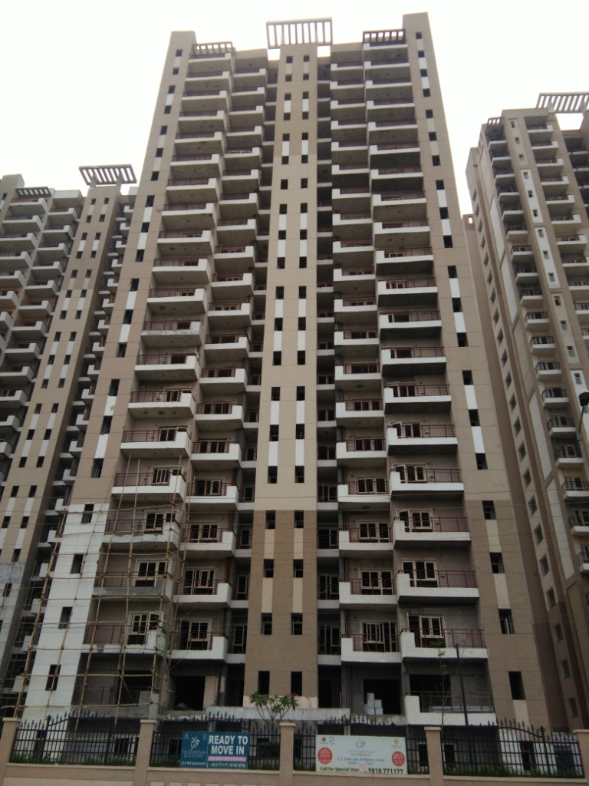
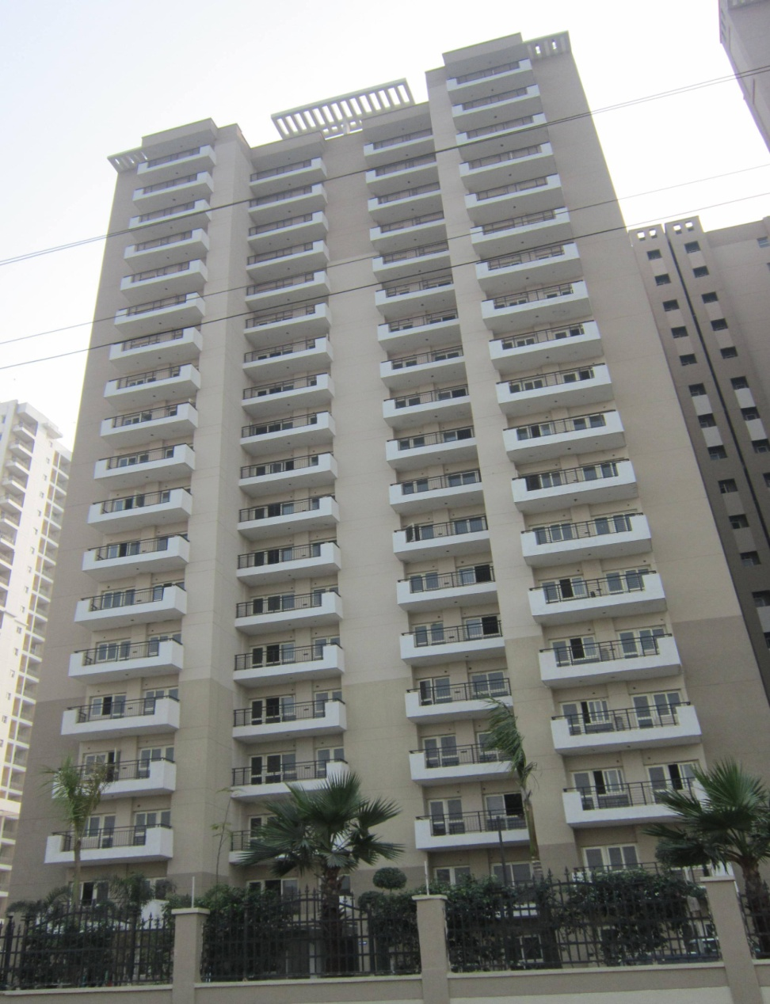
THE GOLDEN PALMS - Multistoryed Apartments at Sector -168 , Noida :–
(Actual view)

Slide 28
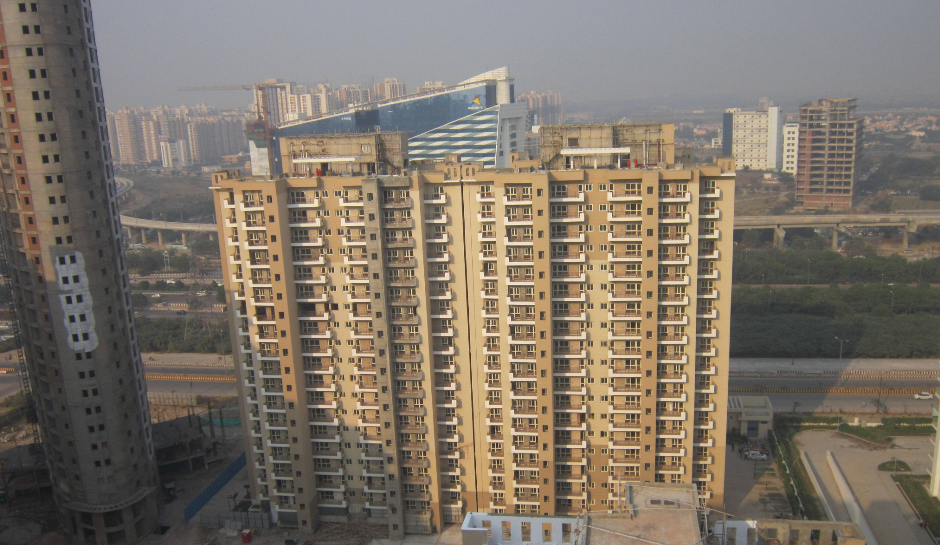
THE GOLDEN PALMS - Multistoryed Apartments at Sector -168, Noida :-
(Actual view)

Slide 29
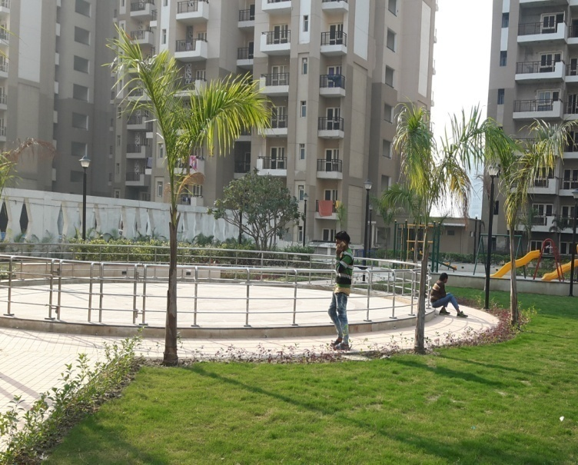
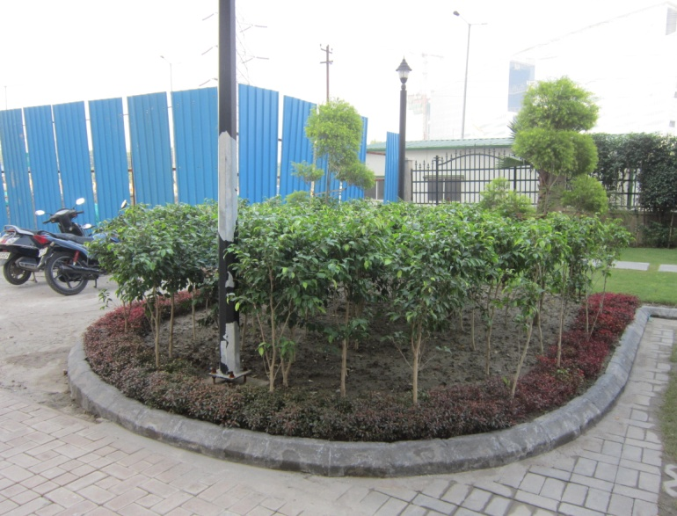
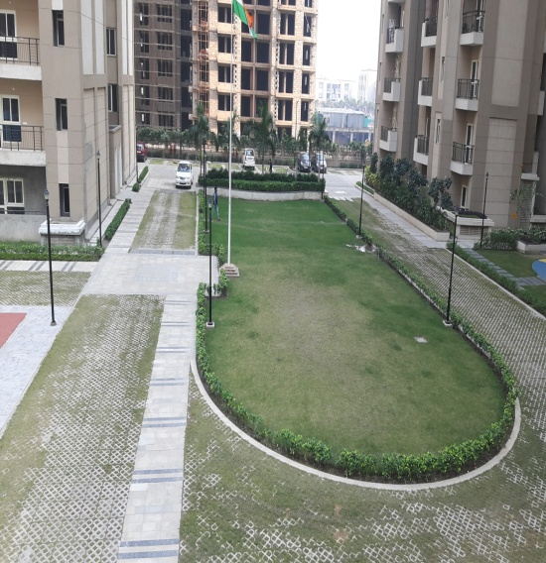
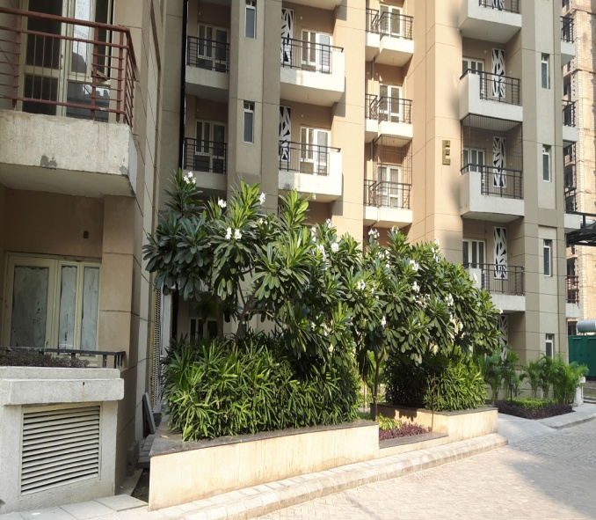
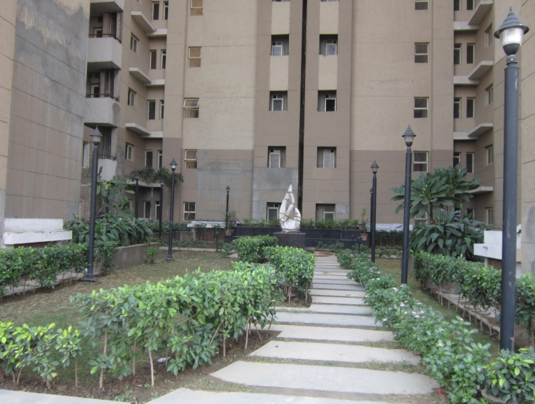
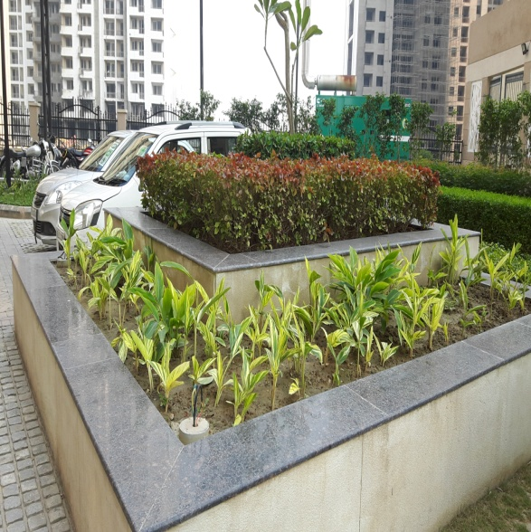
THE GOLDEN PALMS - Central Park at Sector-168, Noida :-
(Actual view)

Slide 30
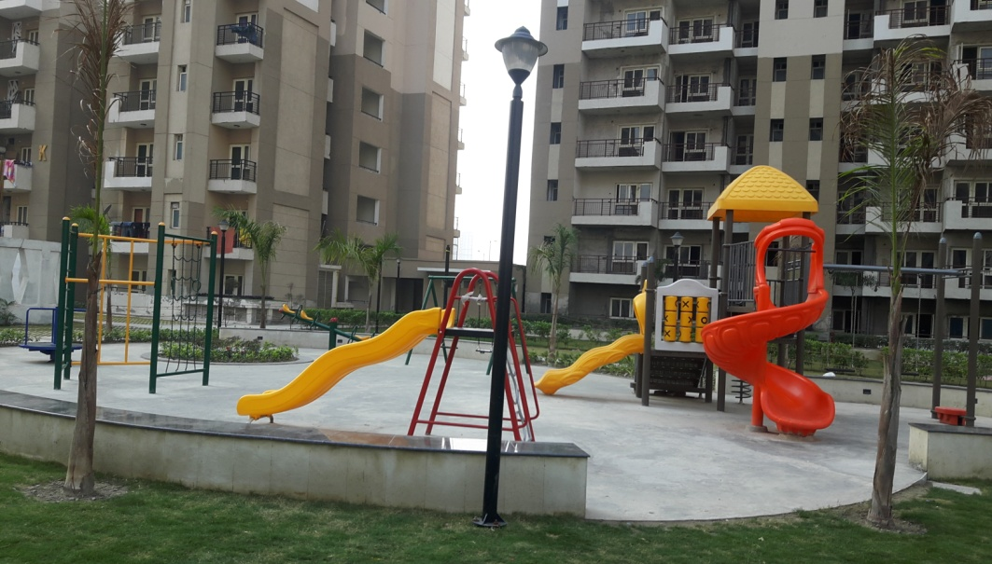
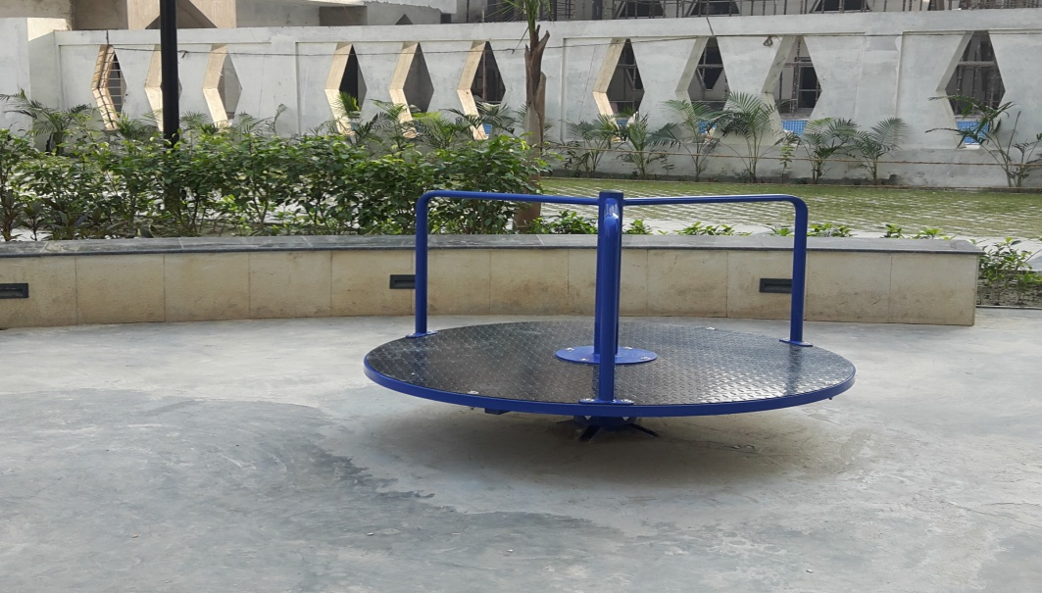
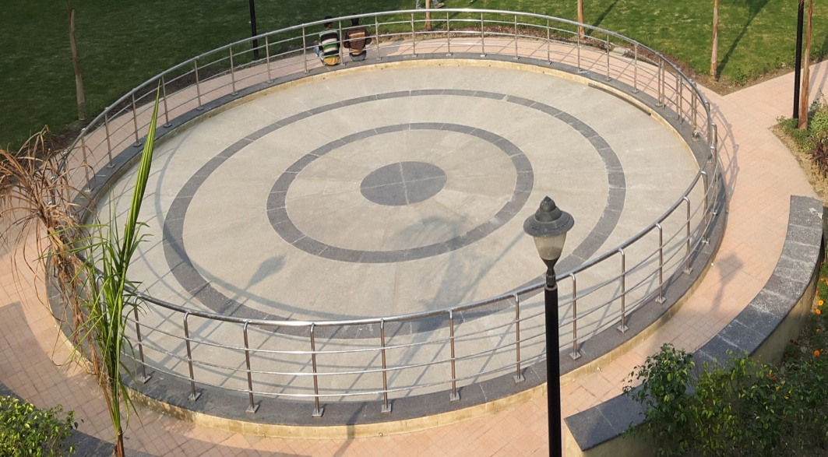
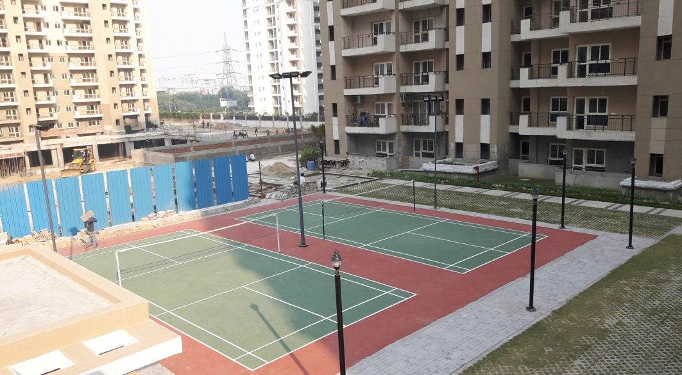
THE GOLDEN PALMS - Kids Play Area at Sector-168, Noida:-

Slide 31
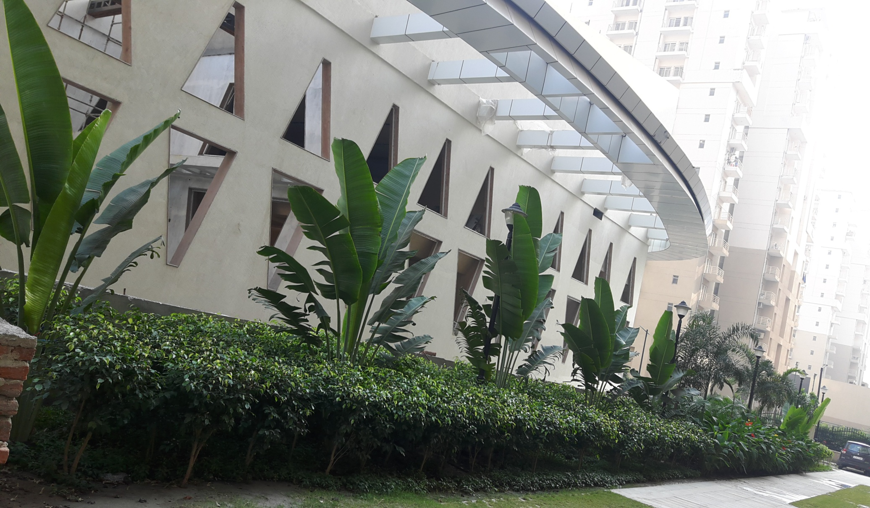
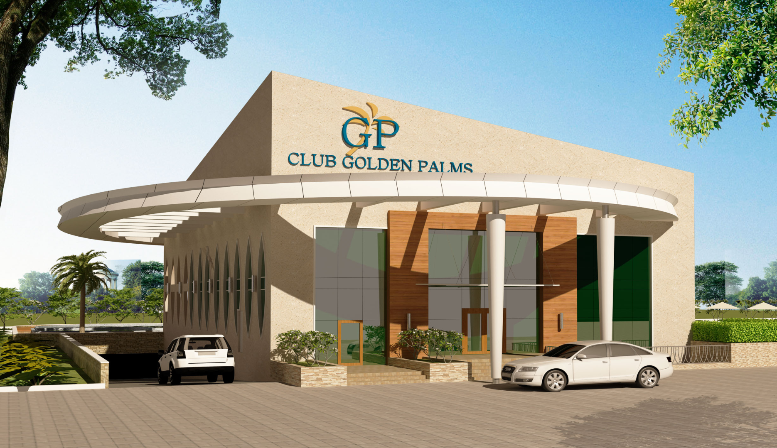
Club House at “The Golden Palm” :-
(Actual view)
(Architect view)

Slide 32
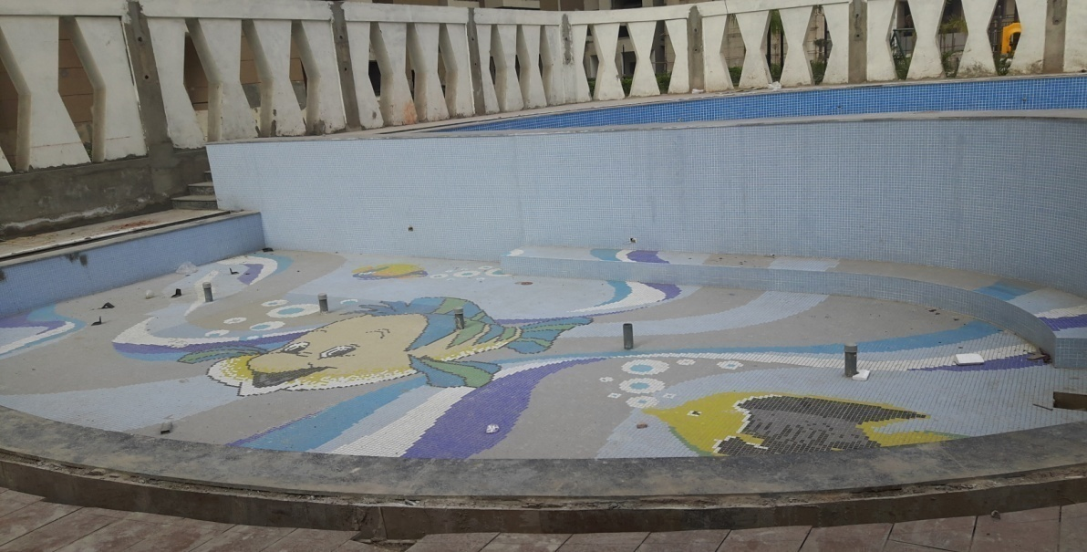
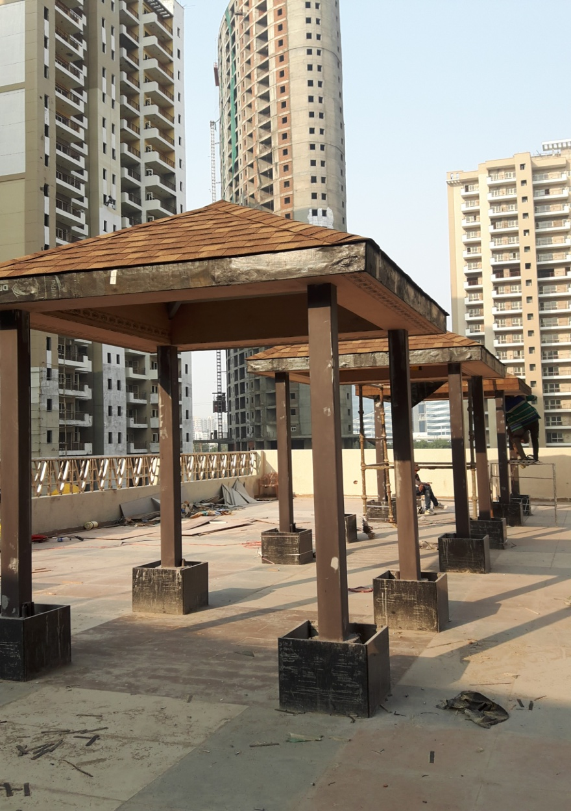
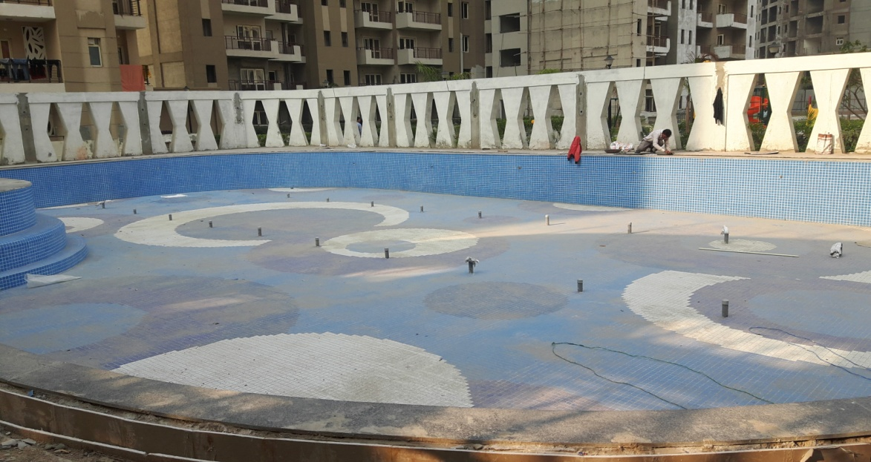
Club House at “The Golden Palm” :-
(Actual view)

Slide 33
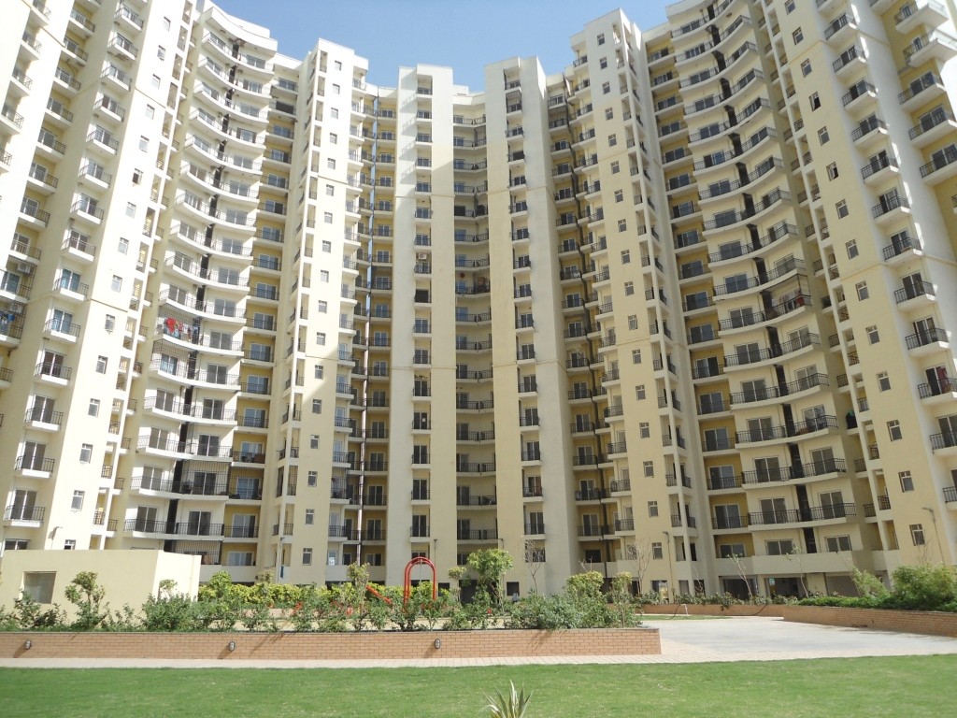
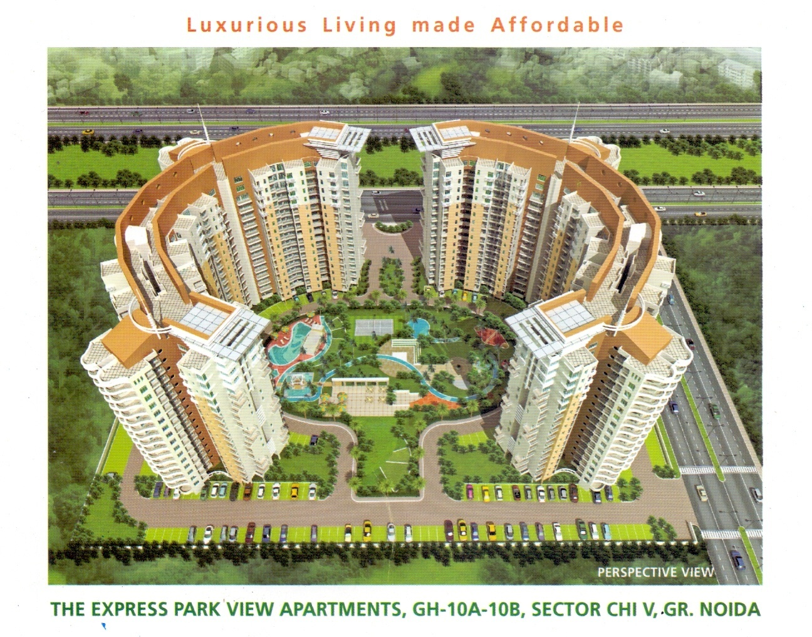
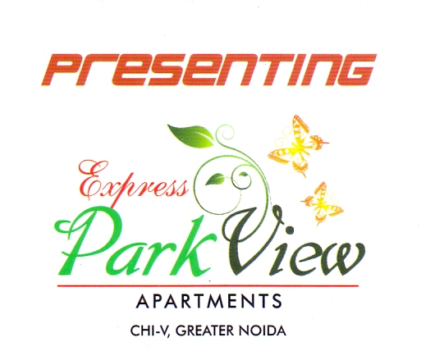
THE EXPRESS PARK VIEW-I, Sector-Chi-V, Greater Noida:-
(Actual view)
(Architect view)

Slide 34
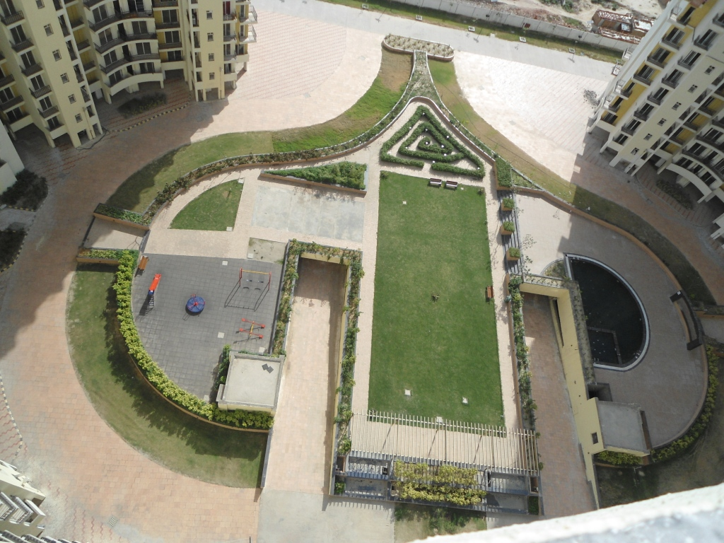
THE EXPRESS PARK VIEW I , Sector- Chi-V, Greater Noida:-

Slide 35
THE EXPRESS PARK VIEW-II, Sector Chi-V, Greater Noida:-
(Actual view)
(Architect view)

Slide 36
THE EXPRESS PARK VIEW-II , Sector- Chi-V, Greater Noida:-
(Actual view)

Slide 37
THE EXPRESS PARK VIEW-II, Sector Chi-V, Greater Noida:-
(Actual view)

Slide 38
THE EXPRESS PARK VIEW-II, Sector Chi-V, Greater Noida:-
(Actual view)

Slide 39
THE ORIGINS – Multistoried Apartments at Jaipur :-
(Actual view)
(Architect view)

Slide 40
THE ORIGINS – Multistoried Apartments at Jaipur :-
(Actual view)

Slide 41
INDOSAM–75- Multistoried Apartments At Sector-75, Noida:-
(Actual view)
(Architect view)

Slide 42
INDOSAM–75- Multistoried Apartments At Sector-75, Noida:-
F
(Actual view)

Slide 43
PARIKRAMA – Multistoried Apartments at Panchkula, Haryana:-
(Actual view)
(Architect view)

Slide 44
PARIKRAMA – Multistoried Apartments at Panchkula, Haryana:-
(Actual view)

Slide 45
PARIKRAMA – Multistoried Apartments at Panchkula, Haryana:-
(Actual view)

Slide 46
Current Projects :-
VINPAR PROJECT– IT Building Project at Sector-142, Noida :-
FASTECH PROJECTS PRIVATE LIMITED
www.fastech.co.in

Slide 47
VINPAR PROJECT– IT Building Project at Sector-142,Noida :-
FASTECH PROJECTS PRIVATE LIMITED
www.fastech.co.in

Slide 48
CHD GREEN PARK RESIDENCY– Independent Floors at Sector-45,Karnal, Haryana :-
FASTECH PROJECTS PRIVATE LIMITED
www.fastech.co.in

Slide 49
Activities: Waterproofing,Plumbing Work,Landscaping & Kids Play Area

Slide 50
Water Treatment Plant & Sewage Treatment Plant:-

Slide 51
Rising Main & Safety

Slide 52
Events
The Golden Palm-Club House Inauguration:-
continue

Slide 53
53

Slide 54
Plant & Machinery : -
Automatic Concrete Batching Plant
Automatic Concrete Pump
Heavy Duty Generator
Heavy Duty Dumper
Transit Mixer
Trucks
Excavator
Automatic Steel / Bar cutting & Bending Machine
Shuttering Materials
Builder Hoist
Compaction Machine
Screed Vibrator
Concrete Mixer
Cube Testing Machine
Drilling Machine
Grass Cutting Machines
Mono Block Pumps
Portable Hoist
Shearing Machine
Submersible Pump
Plastering Gun
Tractor and Trolley
Vibrator
Water Tanker
Weighing Scale
Welding Machine
Scaffolding & Shuttering
Lab equipments
Safety equipments
Material cum Passenger Lifts
Suspended Platform
Weighing scale
Water tanker

Slide 55
Plant & Machinery : -
FASTECH PROJECTS PRIVATE LIMITED
www.fastech.co.in

Slide 56
Plant & Machinery : -

Slide 57
Plant & Machinery : -

Slide 58
Plant & Machinery : -

Slide 59
Plant & Machinery : -
F

Slide 60
Our Team Members:-
S.NO. | DESIGNATIONS
1 | Directors
2 | Head of operation
3 | General managers
3 | Senior project managers
4 | Project managers
5 | HR Managers
6 | Finance & accounts managers
7 | Purchase managers
8 | Safety & quality engineers
9 | Site engineers
10 | Foreman's
11 | Supervisors
12 | Electricians
13 | Machine operators
14 | Lab In-charge and technicians
15 | Accountants
16 | Store keepers
17 | Field executives / Office assistants

Slide 61
Contact Details:-
Fastech Projects (P) Ltd.
Head office at : SF-06 to 09,
IInd floor, Cross River Mall,
Karkardooma, Delhi -110092
Tel: 011 42111886-888
E-mail: info@fastech.co.in
Web : www.fastech.co.in

